Slide 1
Good Auditing Practices Chain of Custody
UTZ Program

Slide 2
Introduction

Slide 3
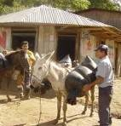

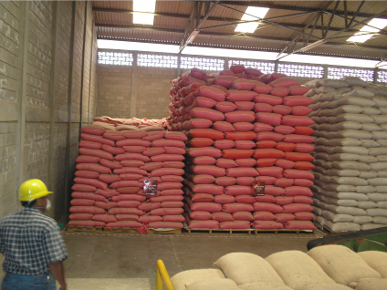
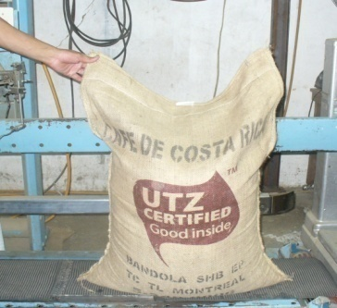
Chain of Custody - What is it?
Set of administrative and technical rules
Traceability all along the supply chain
With the objective to:
Prevent the mixing of UTZ certified products with non-UTZ certified products
Ensure that products with an UTZ claim are indeed UTZ certified
Notes:
3
The Chain of custody is a set of administrative and technical rules designed to provide a high level of confidence that the UTZ Certified product originates from or relates to an UTZ Certified source.
For the traceability levels Identity preserved and segregation, the Chain of Custody includes a set of requirements that ensures physical and administrative separation of UTZ CERTIFIED products from non-certified products throughout the entire supply chain
For the mass balance traceability level, the chain of custody standard ensures the administrative separation of certified goods.
The objectives of the chain of custody are: 1. to prevent the mixing of UTZ certified products with non-UTZ certified products and 2. To ensure that products with an UTZ claim are indeed UTZ certified
Thus, the chain of custody certification ensures traceability along the supply chain.

Slide 4
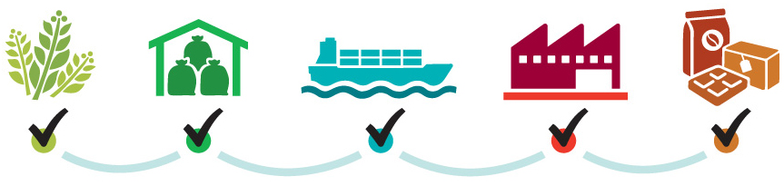
What is the value of traceability?
Assurance that certified products are linked to certified sources
Proof to the logo and/or claim on the product
Link certified producers and buyers
Monitoring of volumes and premiums
Notes:
What is the value of the traceability?
Traceability is the assurance that certified products are linked to certified sources.
It ensures the credibility of the logo or the claim made on a product
Traceability is a strong link between producers and buyers and it also allows a good monitoring of volumes and premiums.
Lastly, traceability builds transparency and trust all along the supply chain.

Slide 5






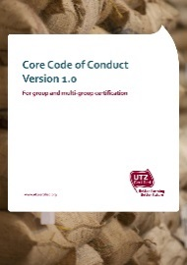
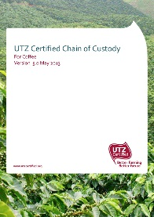

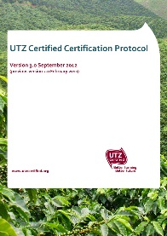

Traceability along the Supply Chain
Code
ChoC
Protocol
Notes:
Producers are certified under the Code of Conduct – SCA are certified under the ChoC.
All parties work with GIP/MTT
Protocol is document in which certification requirements, conditions and procedure is outlined
5

Slide 6





































When Code and when ChoC?
Either
ChoC or Code
Code
ChoC
Coffee
Rooibos
Tea
Cocoa
Hazelnut
Notes:
It is important to realize which activities (and related output products) are covered by Code certification and which ones by ChoC certification.
If you take a look at the picture presented, on the left we see those output products that always require a Code of Conduct audit. On the other extreme, on the right, we see those output products that always require Chain of Custody certification. If you are not sure about the meaning of the Icons, or which output products they represent, you can check this in the corresponding chain of custody annex for that particular commodity.
Let’s go back to the picture now. As you can see, it shows that -for a member that performs one or more physical handling activities resulting in an output product on the left side-, this member must be certified at least for the Code and respective module.
If a member does other physical handling activities taking place at a later stage in the processing chain (so, on the right side of the picture), and meets the three ChoC criteria, it needs to be certified for the Choc.
For coffee certification, as you can see in the middle, there is (literally!) a bit of a grey area. These products in the middle (which are parchment, dried cherries and green coffee) can either be covered under Code or ChoC certification, depending on who requests the audit. If the member being audited is a producer the activities to come to these products in the grey area can be included in their Code audit. However, if it concerns a Supply Chain Actor, these activities and output products can be included under their ChoC certification.
For rooibos certification, this is quite similar. That is, producers who handle up to consumer-end rooibos products, are certified against the Core Code and Rooibos Module for all activities resulting in the final consumer-end product, so this includes the grey area. However, supply chain actors that only conduct activities after secondary processing need to get certified against the ChoC, so only for activities in the gray area.
For tea certification, members who handle up to made tea need to be certified against the Core Code and Tea Module. All further processing activities are covered under the Chain of Custody for Tea.
For Cocoa, it’s the same. The drying, sorting, and bagging of cocoa beans are the activities covered by Code Certification. All other further processing activities such as grinding, pressing or manufacturing are activities included under ChoC certification.
Last, Hazelnut: production of in-shell hazelnuts is covered under the Code. All other physical handling and processing activities are covered by ChoC certification.
For more specific details, please refer to the ChoC annex for each commodity.

Slide 7
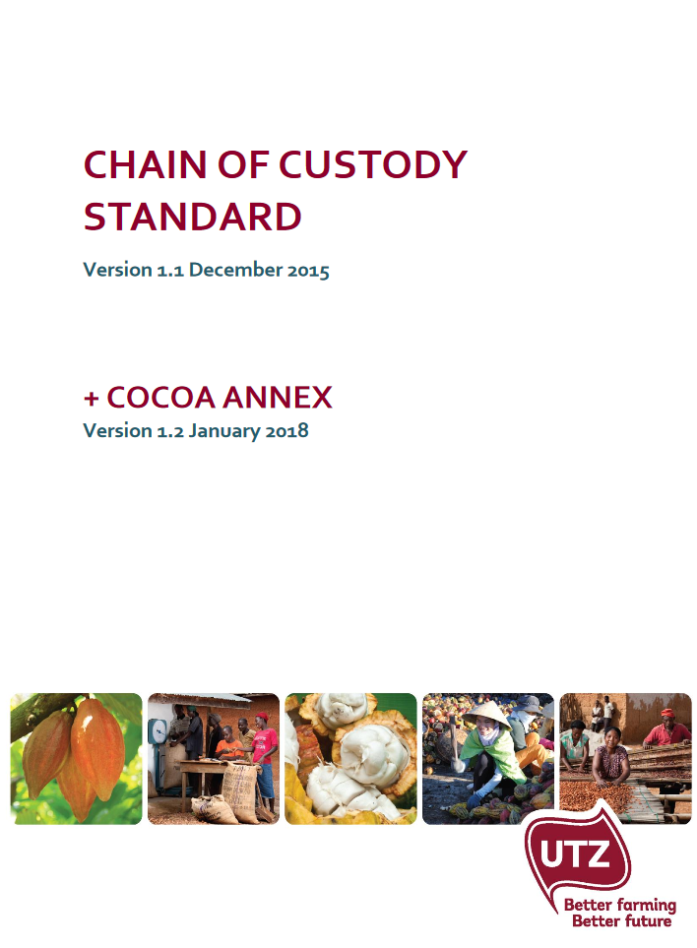
Standard Structure
Chain of Custody Standard
Same control points for all products
Product Annex
Specifications regarding physical handling activities, traceability levels, conversion rates, and GIP transactions and stock activities (available for coffee, cocoa, tea, rooibos and hazelnut)
Notes:
The requirements, or control points, are listed in the ChoC standard, and accompanied by a product annex. The Product Annex corresponds with the product being traded and/or processed but does not include additional requirements. It does include specifications for that product on how to comply with some of the requirements in the ChoC standard. The specifications have to do with physical handling activities, traceability levels, conversion rates, and GIP transactions and stock activities.

Slide 8
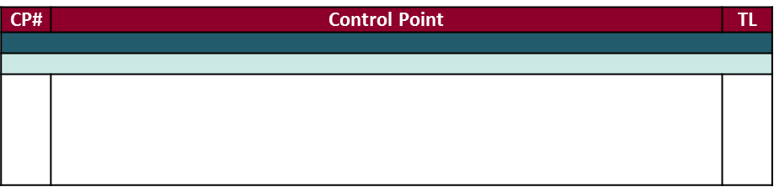

Standard Structure II
If no traceability level is indicated, the CP applies to all levels
MB rules and limitations regarding mixing, 100% volume coverage, and credit exchange are respected.*
* Directs you to the product annex
Some CPs are specific to one/some traceability level(s)
Notes:
When reading the ChoC requirements, you’ll notice a column entitled TL for traceability level. This column indicates to which traceability level the control point applies to. If the column is blank, the control point applies to product of all traceability levels. If it is secified IP, SG, or MB, this means that the control point only applies to the specified TLs.
In the text of some of the control points, you may find an asterisk. The asterisk is an indication that more details are provided in the product annex.

Slide 9
When to conduct the Chain of Custody audit

Slide 10
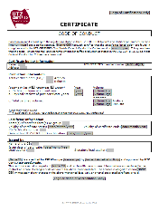
First ChoC Audit – IP/SG
Aug
Jul
Sep
Jun
Oct
Max. timeframe that purchase can be claimed as UTZ
May
Nov
Start date certificate
e.g. 1 Jan 2016 – 31 Dec 2016
Dec
Apr
Mar
Jan
Feb
1st Purchase Received
e.g. 1 Jan 2016
Audit
e.g. 23 Feb 2016
Notes:
For SCAs who operate under IP or SG level, the first audit must be conducted no later than 4 months after they have received their first purchase of UTZ product. That means the audit must take place latest 4 months after the date that the SCA has physically received the input goods or raw material in their warehouse.
Now, if they have an audit before the 1st purchase received date, this is also fine, but this is then considered to be a preps audit, as the member has not started to produce yet because it has not received any UTZ input products yet.
The auditor verifies the records requested in the ChoC for the 4 months prior to the date of audit in order to have an overview of the record keeping of the organization. The records must comply with the ChoC requirements from the beginning of the validity of the certificate.
Product received more than 4 months before the audit date cannot be claimed as UTZ and SCAs cannot sell UTZ product until they have received a valid certificate.
So, if the audit for instance takes place on the 23rd of Feb 2016, then UTZ certified raw material (input product) that was received in the warehouse up to 23 Oct 2015 can be used to produce UTZ certified output product. Also, the auditor must review records back to 23 Oct 2015.
Then, lets talk about the start date of the certificate.
For SCAs who operate at IP or SG level, the validity of the first certificate starts on the date that the SCA received their first purchase of UTZ product.
If the SCA has not received any UTZ product yet, the validity of the first certificate starts when the certification decision is taken by the CB.

Slide 11
Explanation
First certification audit, Protocol page 24, ff.
For SCAs who operate under IP or SG level, the first audit must be conducted no later than 4 months after they have received their first purchase of UTZ product. Product received more than 4 months before the audit date cannot be claimed as UTZ.
For SCAs who operate at MB level, the first audit must be conducted no later than 4 months after their first purchase of UTZ product. Product purchased more than 4 months before the audit date cannot be claimed as UTZ.
The auditor verifies the records requested in the ChoC for the 4 months prior to the date of audit in order to have an overview of the record keeping of the organization.
SCAs cannot sell UTZ product until they have received a valid certificate/ the site is added to the multi-site certificate

Slide 12
When should the audit take place?
 |  | 1st certification audit | Subsequent certification audit
ChoC | IP/SG | X > 4 mnts | 4 mnts < B > 4 mnts
 | MB | Y > 4 mnts | idem as above
What is the start date of the certificate/ license?
 |  | 1st certificate | Subsequent certificate
ChoC | IP/SG | Date X or Date of Certification Decision | Following the cycle (1 or 2 yrs validity)
 | MB | Date of Certification Decision | Following the cycle (1 or 2 yrs validity)
X = date 1st UTZ purchase received | B = date of the expiry of the certificate
Y = date 1st UTZ product purchased

Slide 13
Traceability Levels
Notes:
In this module, you will learn the basics about the three traceability levels used in the UTZ Certified program.

Slide 14
Three traceability levels
Identity Preserved
Information on producer kept throughout the supply chain
Segregation
Certified cocoa is kept segregated throughout the supply chain
Assurance
Physical traceability
IP and Segregation: Assurance of the physical and administrative separation of certified goods
Mass Balance: Assurance of the administrative separation of certified goods
Mass balance
Certified cocoa and conventional cocoa are mixed during
storage or production
Administrative traceability
Flexibility
Notes:
The three traceability levels possible for UTZ product are IP, SG, and MB. The traceability level influences the method used to verify the traceability of the certified product. They range from very strict traceability (IP being the most strict as the information about the producer of the UTZ product is maintained through the supply chain) to allowing more flexibilty for the operator (mass balance). Regardless of the traceability level used, members who comply with the UTZ standards ensure that the UTZ product is physically or administratively related to UTZ certified producers. SCAs can only purchase product of equal or stricter traceability level than the one they are certified for.

Slide 15
Identity Preserved
The identity of a certified producer or producer group is maintained along the supply chain. The product can be traced all the way back to the producer or producer group that it originates from.
Producer A
First Buyer warehouse
Producer A
Producer B
Producer B
purchase
Conventional
Producer C
Notes:
Identity preserved implies that the identity of the producer or producer group who produced the UTZ certified product is known throughout the supply chain. When a SCA , in this case a first buyer, meaning the SCA which purchased product from a producer/producer group, if the first buyer purchases IP product and wishes to maintain the IP traceability level when selling to a next buyer, the SCA must keep the UTZ product purchased from each UTZ certified producer separate from each other, and separate from conventional product.
It is important to note that all product sold by a producer or producer group is considered IP. Producers or producer groups cannot operate at any other traceability level. This means that a producer or a producer group must at all times keep UTZ product separate from non-UTZ product.

Slide 16
Segregation
UTZ certified product from different producers/producer groups can be mixed. It is certain that the product was produced by UTZ certified producers, however the identity of the specific producers is lost.
Producer A
First Buyer warehouse
Producer B
purchase
Conventional
Producer C
Notes:
Under the segregated traceability level, UTZ product from different producers or producers groups can be mixed. If a SCA, in this case a first buyer, purchases certified product from several certified producers or groups and wishes to sell the UTZ product to a next buyer under the segregated traceability level, this SCA can mix together all certified product coming from certified producers or groups, but must keep the certified product separate from conventional product.

Slide 17
Mass Balance
Administrative traceability of a certified product. The proportion of outputs sold as UTZ is equal to the proportion of inputs purchased as UTZ.
(please see slide 28 ff for more information)
Producer A
First Buyer warehouse
Producer B
purchase
sold as
Producer C
Notes:
Mass balance refers to adminstrative traceability of a product, rather than physical traceability. This means that UTZ certified product can be mixed with conventional product (for instance in the first buyer warehouse). What is important is that the proportion of product sold as UTZ does not exceed the proportion of product purchased as UTZ. Here, the output volume sold as UTZ is the same as the input volume purchased as UTZ.
The MB traceability level can already be used by the first buyer. This traceability level only applies to UTZ certified cocoa and hazelnuts. Other products such as coffee and tea can only be traded at either IP or SG level.

Slide 18
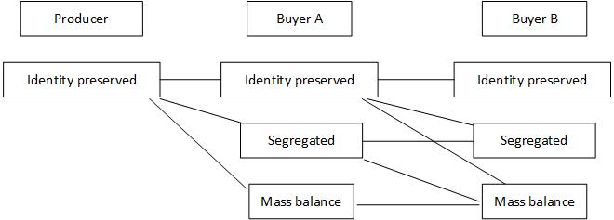
SCAs can only sell product under the same or weaker traceability level as the one they purchased it for.
Notes:
SCAs can only purchase product of equal or stricter traceability level than the one they are certified for. For example, this means that if a processor is only certified at the segregated traceability level, they cannot purchase MB product.

Slide 19
Traceability Systems
GIP and MultiTrace

Slide 20
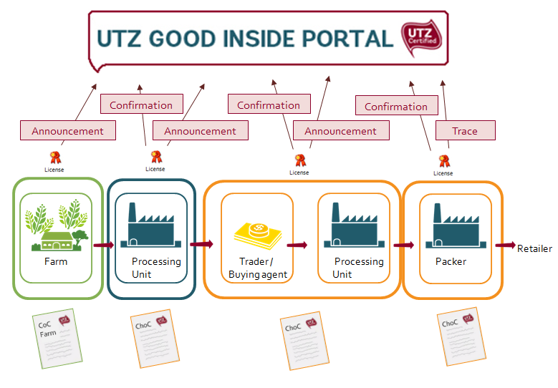
What is the Good Inside Portal?
→ An online traceability system for sustainably produced goods
Notes:
The Good Inside Portal is our tool to ensure traceability between all of the actors in the supply chain, from the producer to the packer.
It is an online traceability system in which members have to register transactions of UTZ certified products.

Slide 21
What is MultiTrace? – need a nice slide here, @Cintia, please help

Slide 22
Who needs certification?

Slide 23




Who must be certified?
Legal ownership?
AND
Chain of Custody Certification
Physically handle
UTZ product?
AND
Product Claim (B2B/B2C)
The physical handling activities are different for each commodity and can be found in the Chain of Custody product annex.
For coffee also actors that physically handle the coffee from cherry to green coffee (even as subcontractor) must be certified.
Notes:
Before performing a chain of custody audit, you must determine whether your client needs to be certified or not.
If the client meets the following three critieria, then they must be certified. The criteria are, if they own UTZ Certified product, if they physically handle the product, and if they make a product claim. Depending on the commodity, different activities are considered as physical handling; these activities can be found in the chain of custody document
For coffee, also the supply chain actor that physically handle the coffee from cherry to green coffee must be certified under chain of custody
A product claim means that the member claims the product as UTZ when they sell it onwards. A product claim can be either on a B2B or B2C transaction

Slide 24

What about traders?
Legal ownership?
If one of the three conditions does not apply (such as physical handling in the case of traders), Chain of Custody certification
not needed and SCA will receive a license instead
BUT
DO NOT Physically
handle the
UTZ product?
AND
Product Claim (B2B/B2C)
Notes:
Traders typically don’t meet the 3 criteria as they often don’t physically handle the certified product. Thus, they don’t need to be certified if they are simply trading.

Slide 25
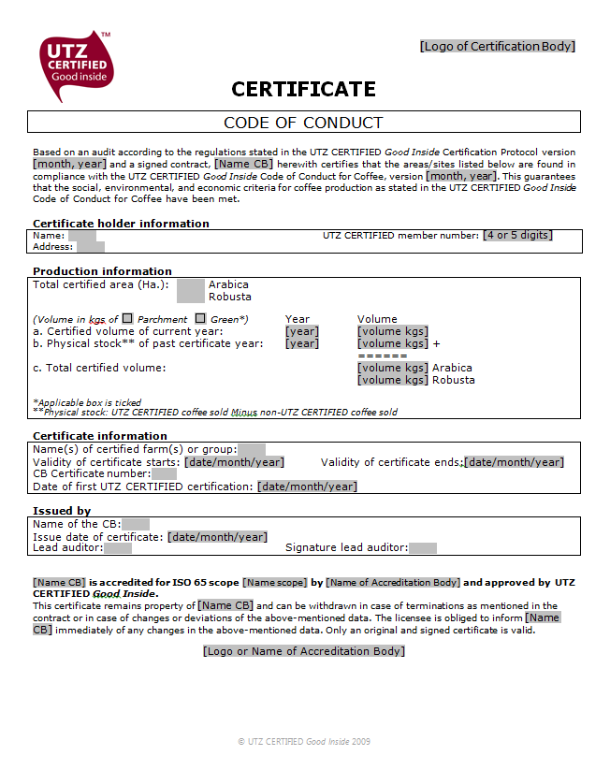
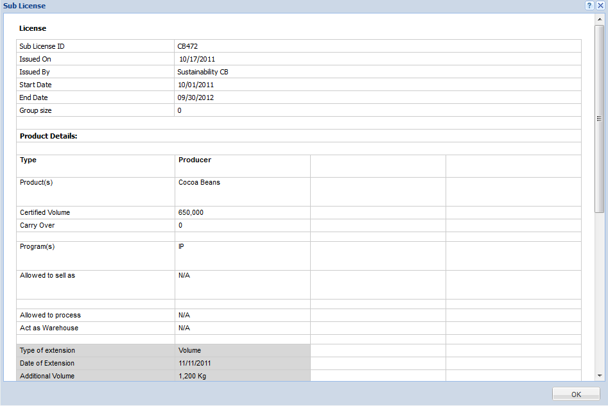
A license …
A certificate is…
…the document issued by the Certification Body when an audited producer or supply chain actor complies with the requirements of UTZ Certified.
… allows the UTZ Certified SCA to access and use the Traceability System to record their transactions of UTZ products.
The information in the license reflects the information from the certificate.

Slide 26




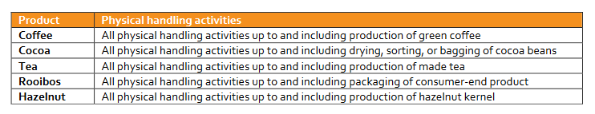
What about subcontractors?
Company A
Owns
Claims
Subcontractor
Handles
Subcontractors generally do not need to be certified. The subcontracting company however needs to have the subcontractor’s activities included in their scope of audit. In below case, the auditor of company A may decide to physically audit their subcontractor. Physical audits for subcontractors engaged in the following physical handling are always mandatory:
Notes:
Subcontractors do not need to be certified either. In this case, if Company A subcontracts all physical handling to a subcontractor, Company A must be certified. Company A is responsible for the compliance of the subcontractor with the UTZ ChoC Standard.

Slide 27
If the subcontractor is already certified on their own, it is not necessary for Company A to be certified.
Company A
Owns
Claims
Subcontractor
Handles
Notes:
If the subcontractor is already certified on their own, it is not necessarily for Company A do be certified.

Slide 28
Summary – who does not need certification:
Traders that do not physically handle UTZ product and do not subcontract activities that fall under the category “physical handling”
Traders that subcontract already certified units to conduct activities that fall under the category “physical handling”
Small volume supply chain actors (200 MT for coffee/tea and 100 MT for cocoa, total volume certified + not certified)
Members purchasing UTZ certified input, but who do not make a claim about UTZ Certified or sustainable / responsible sourcing on product level
Companies that have gone through an RA audit are able to apply for mutual recognition and receive an UTZ trading license without needing an audit
Notes:
As a review, the following are the types of members that do not need to be certified
Traders that do not perform physical handling activities with the UTZ products and don’t subcontract such activities
Traders that subcontracts already certified units to conduct an activity that falls under the category ‘physical handling’
Small volume supply chain actors. The volume threshold depends on the product; for coffee and tea those who handle up to 200 MT of certified + non-certified product, and for cocoa those who handle up to 100 MT of certified + non-certified cocoa are considered SVOs.
Members that purchase UTZ certified products but that don’t make a claim about UTZ or sustainable or responsible sourcing at product level don’t need to be certified
Members in these situations sign a declaration with UTZ Certified and still receive a license in the GIP so that they can register transactions.

Slide 29
Timelines for the certification process

Slide 30
Non-conformities
NCs closed?
Audit
NCs
Follow-up audit
No
New
Audit
Time to solve NCs
Non-certfication
Decertification (withdrawn if certificate still active)
No NCs
Max. 12 weeks
Yes
Suspension
Certificate
Notes:
Weeks rather than working days
Decertification, not cancellation
Non-closure of NCs within 12 weeks will lead to non-certification. After a certificate has been withdrawn, the member shall wait to receive a new audit (at least until end of withdrawn certificate) or following the Non-certification rules: (one harvest period or six months)
Suspension: up to 3 months, in case of minor deviations (that don’t have impact on UTZ/CB credibility) from the UTZ standards found outside of the (re)certification process.
Critical issues:
Systemic failure of the IMS
Violation of national laws, local laws or CBAs
Fraud, inaction or cover-up up (e.g. conventional volume being claimed as UTZ or misuse of premium payment)
irreversible non-compliant practices, for example issues impacting human health, nature or the integrity of the UTZ product

Slide 31
Timeline on License Request Process
YES
12 weeks
NC Handling timeline
Audit
NCs?
NO
4 weeks
Certification decision
1 week
Submit license request
1 week
UTZ reviews license request
CB to address comments
1 week
OK?
NO
YES
Issue
License
Issue Certificate
Notes:
If the auditing team does not find any NCs, the certifier needs to make the certification decision within 4 weeks after the last audit date.
After the certification decision is made, the CB has1 week to request the license in the GIP.
UTZ needs to review the license within 1 week.
In the case the license is approved, the license is officially issued and the CB can issue the certificate to the member.
In the case UTZ has questions about the license, the CB has 7 working days to clarify and to re-submit the license. UTZ then has 5 days again to review the resubmitted license.

Slide 32
Interpretation of selected Control Points

Slide 33

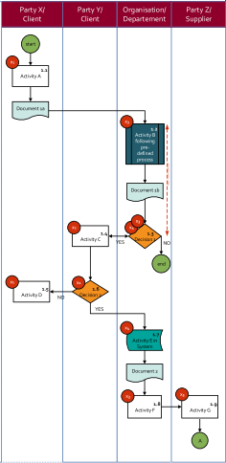

CP 1
The SCA has a clearly documented management system, which addresses each applicable UTZ Certified Chain of Custody requirement.
The documented control system:
a) specifies the personnel responsible for the various
requirements of the Chain of Custody Standard.
b) specifies the procedures in place for the implementation of the
Chain of Custody Standard. Procedures in place:
- take into account the traceability program level(s);
- specify how records are kept.
c) provides templates, forms, records, and documents necessary for compliance with the standard.
If the SCA has a computerized tracking and traceability system such as an ERP system, it must cover all the traceability elements of the Chain of Custody Standard.
All documentation must be legible, dated, and up-to-date.

Slide 34

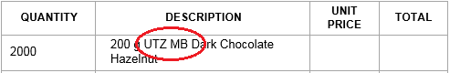
CP 7
The SCA operates a system for ensuring, verifying, and monitoring that the product purchased as UTZ certified is indeed UTZ certified.
This system includes:
a) Verification of the validity of the supplier's UTZ Certified license.
Any supplier must have a valid UTZ Certified license at the moment
the product is claimed as UTZ certified.
b) Verification of invoices and/or documents coming from the supplier. Documentation must include a reference to "UTZ" and to the corresponding traceability level to identify which products are traded as “UTZ”.
c) Verification that inputs received are of equal or “stronger” traceability level than the level the SCA is certified for.
d) Ensuring a transaction ID is available for all purchases (or group of purchases) of UTZ certified product traded in the GIP. This ID is generated in the GIP with every transaction of UTZ certified product.

Slide 35




CP 9
Multi-certified includes products certified as UTZ and against other voluntary standards or industry sustainability initiatives. www.standardsmap.org gives a good overview of the voluntary standards.
If product is purchased as multi-certified, the equivalent amount can be sold as multi-certified. If the equivalent volume is sold under one standard/initiative only, that volume cannot be sold under the other scheme anymore.
The SCA must then remove the volume from their stock in the traceability system.
100 kgs
100 kgs
100 kgs MB
REMOVE

Slide 36



CP 16/17 (applicable to first buyers)
A premium is mandatory
Procedure is agreed with producer/producer group
and includes: amount and timing
UTZ premium = cash, net of deductions and in kind payments
Acknowledgement of payment is available
UTZ premium must be registered in GIP/MTT

Slide 37




What is the UTZ premium?
Group Member Premium available at Code of Conduct level
“First Buyer”
Premium Procedure for expenditure of premium at producer level (according to Code of Conduct requirements – G.A.26/27)
Premium Procedure between Code of Conduct holder (producer) and the first buyer
Cash Amount vs. In-kind

Slide 38
Defining Premium
“The UTZ Premium is an additional cash amount paid above the market price for a similar conventional (non-certified/non-verified) product, because the product is sustainably produced and meets the UTZ standards. The UTZ premium is mandatory and agreed upon between the certified group or producer and the first buyer. It is paid net of any deductions for repayment of pre-financed goods or services and is registered in the UTZ Good Inside Portal”

Slide 39






How can the premium be spent (G.A.26 and 27)?
Group
Management
Products and services for the group
Group Member premium
(in cash and/ or
in tangible goods)
“Use of UTZ Premium”
Procedure
Group members clearly benefit from UTZ premium
Notes:
Clarify that the procedure needs to be communicated to group members
And records need to be kept.
Despues de haber recibido y entrado la prima al Portal, el miembro lo puede gastar en:
Administracion
Productor y servicios para el grupo
Y en la prima de miembro de grupo (en efectivo y /o en especie), pero debe beneficiar claramente a los miembros del grupo
La prima de miembro de grupo no incluye los gastos de administración del grupo (como el uso de la prima para costos de auditoría u otros propósitos administrativos) , ni los servicios o productos entregados a todo el grupo/comunidad (como instalaciones o capacitaciones),

Slide 40
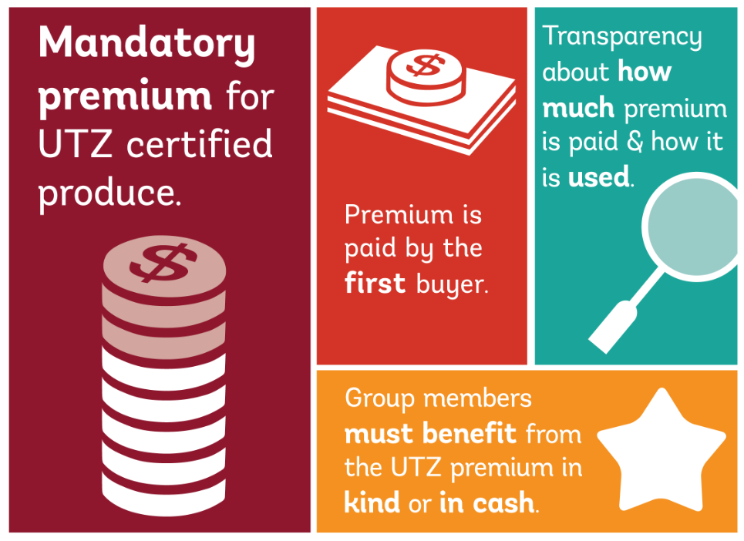

Slide 41
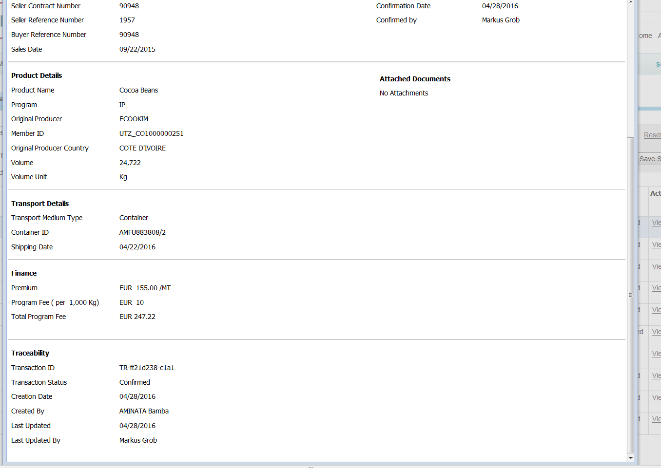
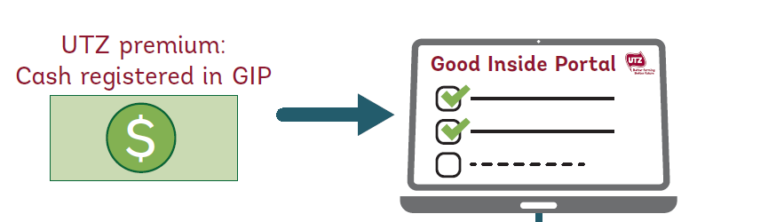
Premium in GIP – per transaction

Slide 42
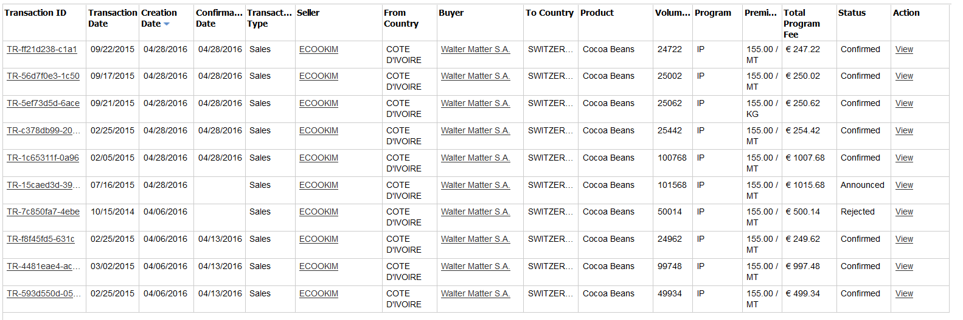
Premium in GIP – for all transactions

Slide 43
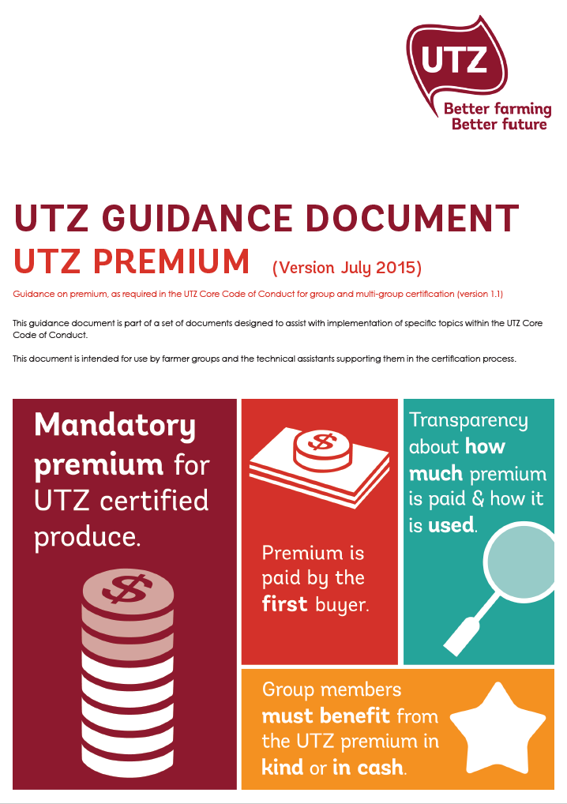

Guidance documents
Producers
SCAs

Slide 44

CP 21 (IP/SG)
No mixing of UTZ certified product with non-UTZ certified product
A limited amount of mixing (representing maximum 10% of the volume of the UTZ product) may occur only as a result of unintentional mixing
Unintentional mixing can include mixing due to exceptional circumstances:
-shipment delay
-no supply from a specific origin of the required quality

Slide 45
Mass Balance Rules and Limitations
(CP 19) – for cocoa and hazelnut
Notes:
This module will introduce you to the rules and limitations of the mass balance traceability level, with respect to mixing, 100% volume coverage, and credit exchange. This relates in particular to control point 19, which requires the SCA to respect the rules and limitations of mass balance. These rules and limitations are further explaned in the Mass Balance chapter of the product annex for cocoa.

Slide 46
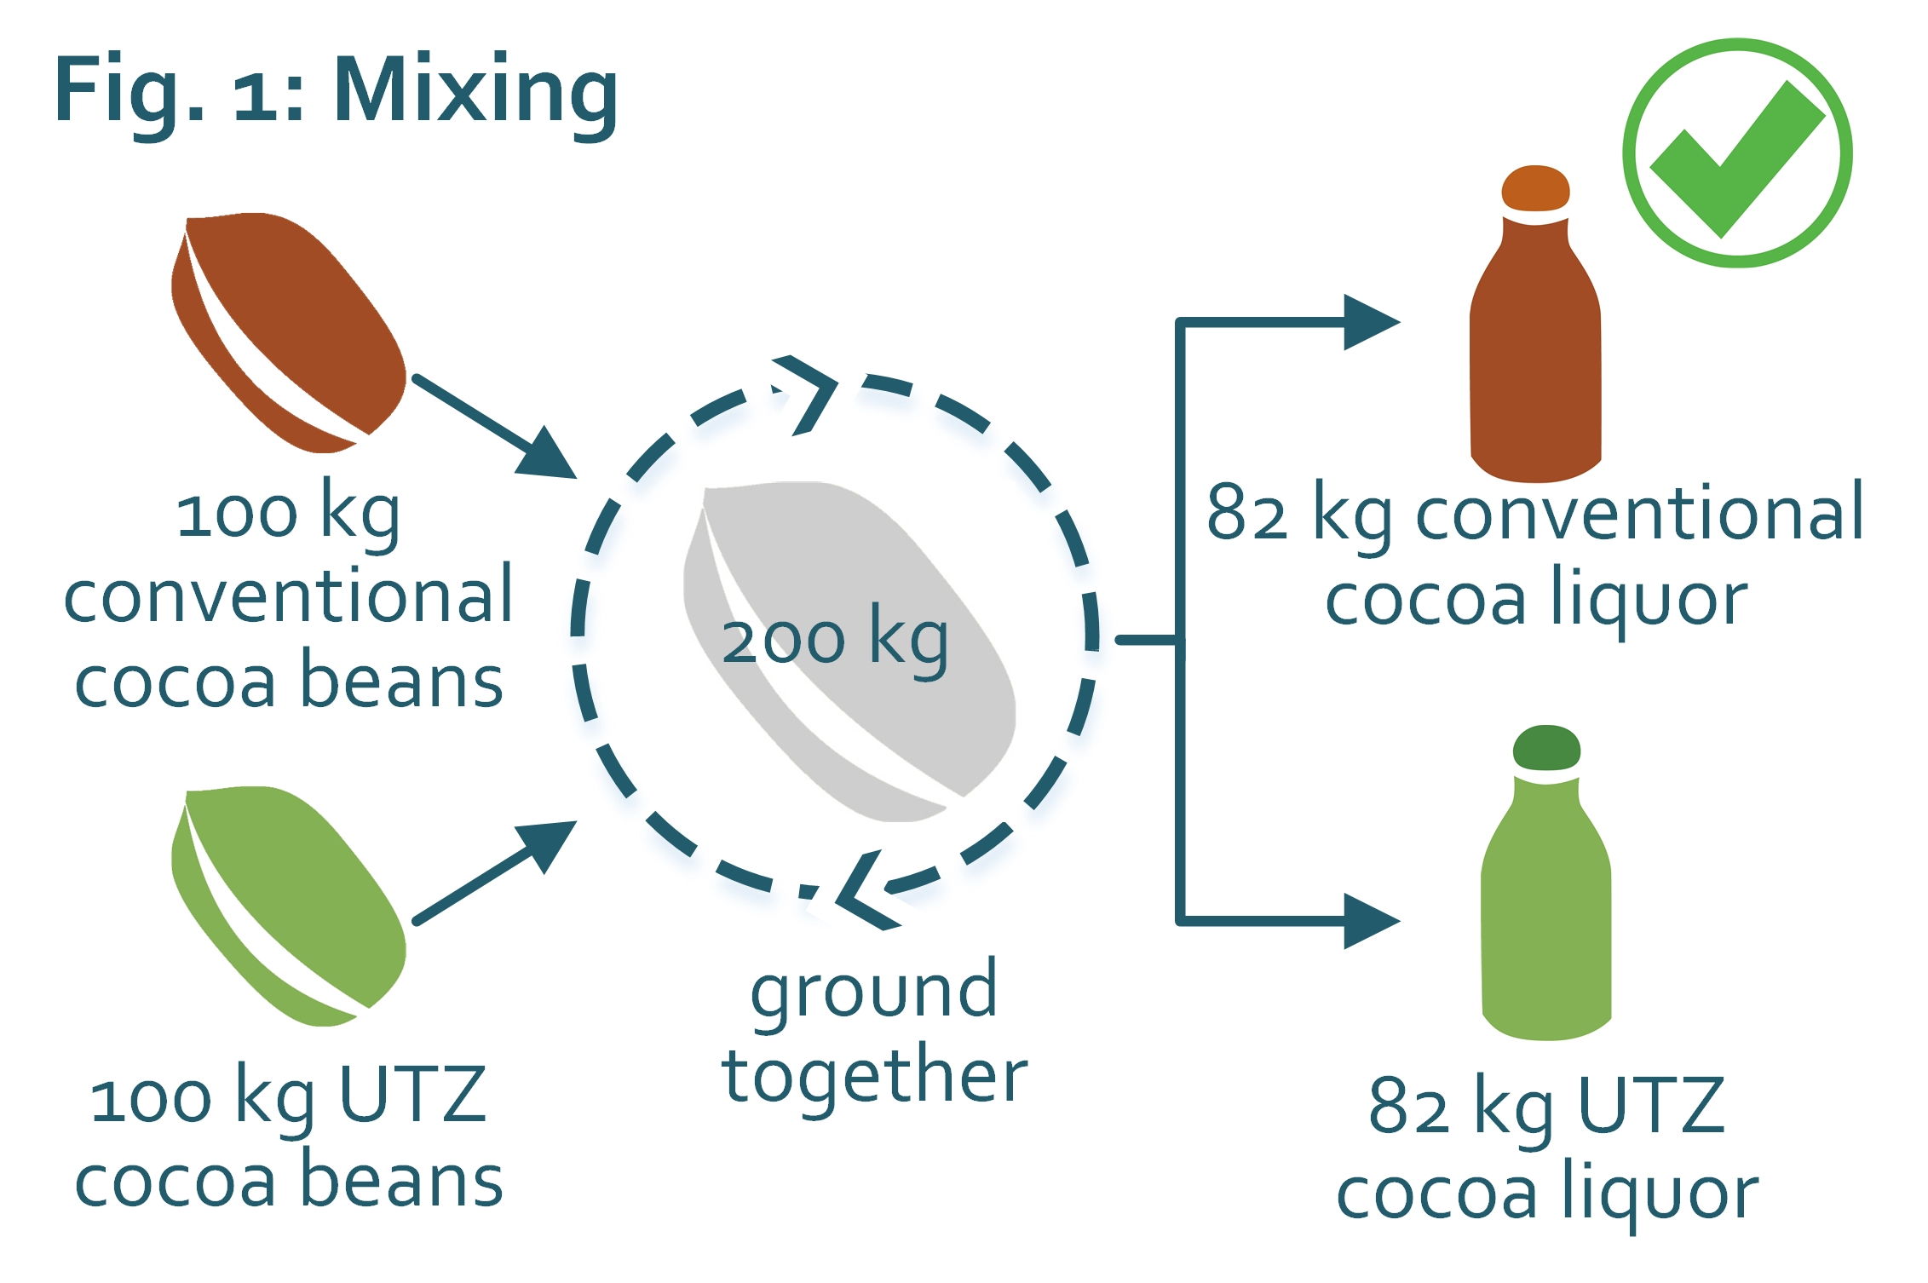
Mixing – Cocoa
Under Mass Balance, conventional cocoa can be mixed with UTZ cocoa, as long as the volume of output = volume of input.
*In this example, the fixed conversion rate of 82% from cocoa beans to cocoa liquor is taken into consideration
Notes:
With MB, UTZ cocoa and conventional cocoa can be mixed, as long as the output volume claimed as UTZ is not more than the UTZ input volume. For instance, during the grinding process 100 kgs of conventional beans could be ground together with 100 kgs of UTZ cocoa beans. In this case, 82 kgs of cocoa liquor can be sold with the UTZ claim. Note that the conversion rate from cocoa beans to cocoa liquor is 82%.

Slide 47
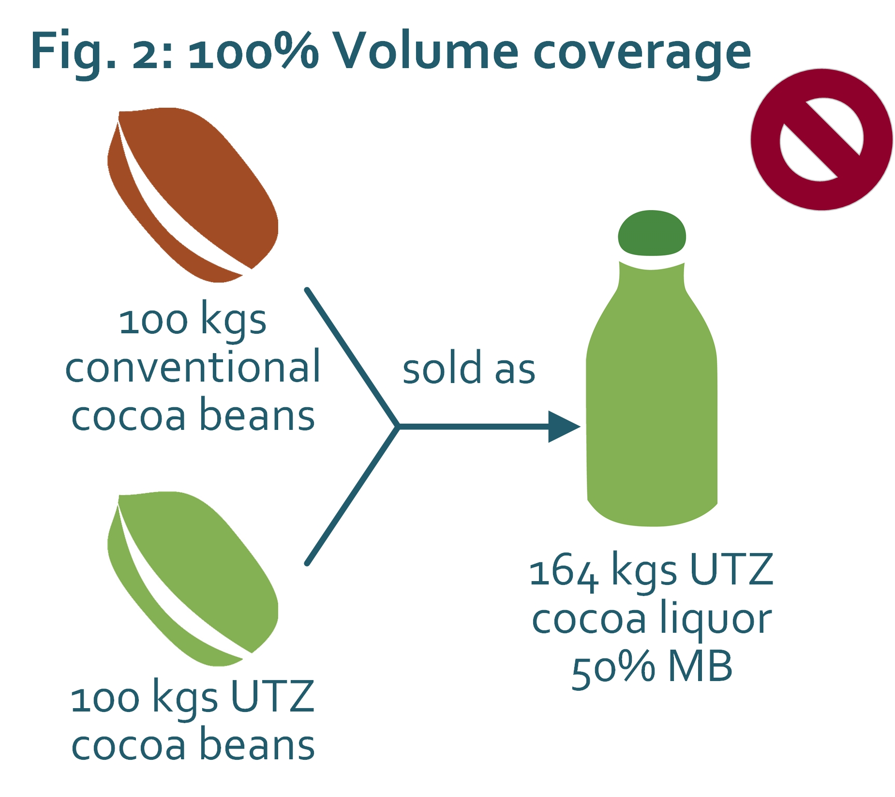
100% Volume Coverage
100% of the cocoa content needed for a product must have been purchased as UTZ.
A product cannot be sold as anything less than 100% UTZ MB.
One hundred percent of the volume of cocoa in a product sold as UTZ MB must be deducted from the SCA’s credit account or sold or traced from the SCA’s GIP stock.
Notes:
We often receive the question “Is there a minimum percent of UTZ cocoa that has to be in a product in order to claim it as UTZ?” The answer is that with MB, there is no minimum % content of UTZ cocoa in the product which physicially comes from UTZ farmers. In fact, it could be that an UTZ MB chocolate bar does not contain a single bean of cocoa produced by an UTZ certified farmer. However, we do say there must be 100% volume coverage of the cocoa content in the product. This means that 100% of the cocoa content needed for a product must have been purchased as UTZ by the processor. A product cannot be sold as anything less than 100% UTZ MB. It is not possible to sell a volume of UTZ cocoa as 50% UTZ , as seen in this example. When a product is sold as UTZ MB, 100% of the cocoa in this product must be sold or traced from the SCAs GIP account, or deducted from the SCAs credit account.

Slide 48
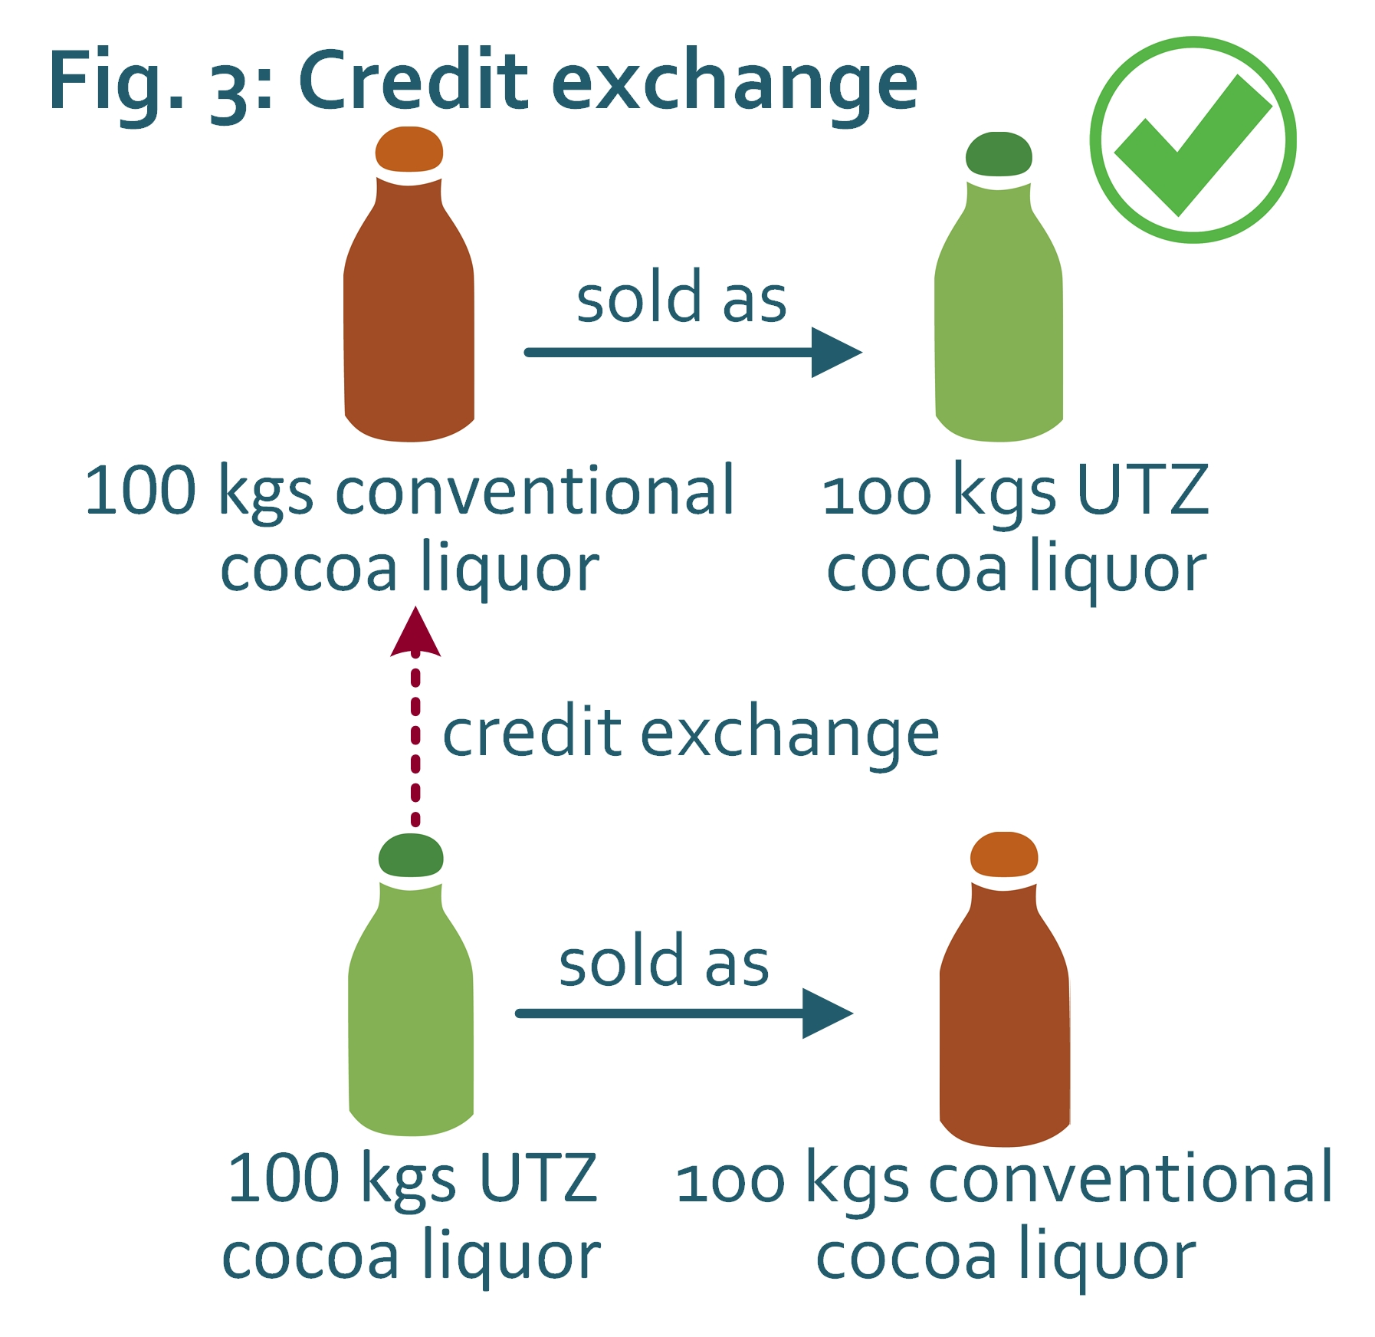
Credit exchange
MB allows credits to be exchanged between UTZ and conventional similar products.
Notes:
MB permits credit exchange between UTZ products and conventional products. If for instance a grinder has 100 kgs of conventional cocoa liquor, and 100 kgs of UTZ cocoa liquor, they could sell the conventional liquor as UTZ, as long as they sell the UTZ cocoa liquor as conventional. This is considered credit exchange between similar products.

Slide 49






Credit exchange
Trade within the Good Inside Portal
Trade outside the Good Inside Portal
cocoa butter
cocoa beans
cocoa nibs
cocoa liquor
non-pure cocoa products
cocoa powder
Conversion / Credit transfer ALLOWED
Conversion / Credit transfer NOT ALLOWED (After July 1st 2016)
Notes:
Credit exchange is also allowed between different types of cocoa products. Currently credits can be exchanged in any direction, and between any type of cocoa product. This means that if processor has 100 kgs of UTZ butter, and wants to sell 100 kgs of conventional cocoa liquor as UTZ, this is possible. However, after July 1st 2016, what we call MB backwards conversions will not be allowed. MB backwards conversions are exchanges of credits from a product farther down in the supply chain, back to a product produced earlier on in the supply chain. Let’s take a closer look in the following slides.

Slide 50
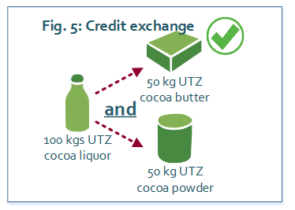
Credit exchange
Credit exchange is only be possible from liquor to butter or liquor to powder, but not in any other direction. The conversion ratio of 1:0.5:0.5 between liquor to butter and powder is to be maintained, always.
Notes:
Currently, it is possible to exchange credits between liquor, butter, and powder, in any direction, at a 1:1 ratio. 100 kgs of conventional cocoa butter can be converted in the gIP to 100 kgs cocoa powder, and the SCA could sell 100 kgs cocoa powder as UTZ. The SCA has the flexibility to convert liquor, butter, and powder in any direction in order to meet the demand for a particular product as UTZ. However, after July 1st 2016, credits can only be exchanged from cocoa liquor to cocoa butter, or from cocoa liquor to cocoa powder. This reflects the direction of the physical processing of cocoa.

Slide 51
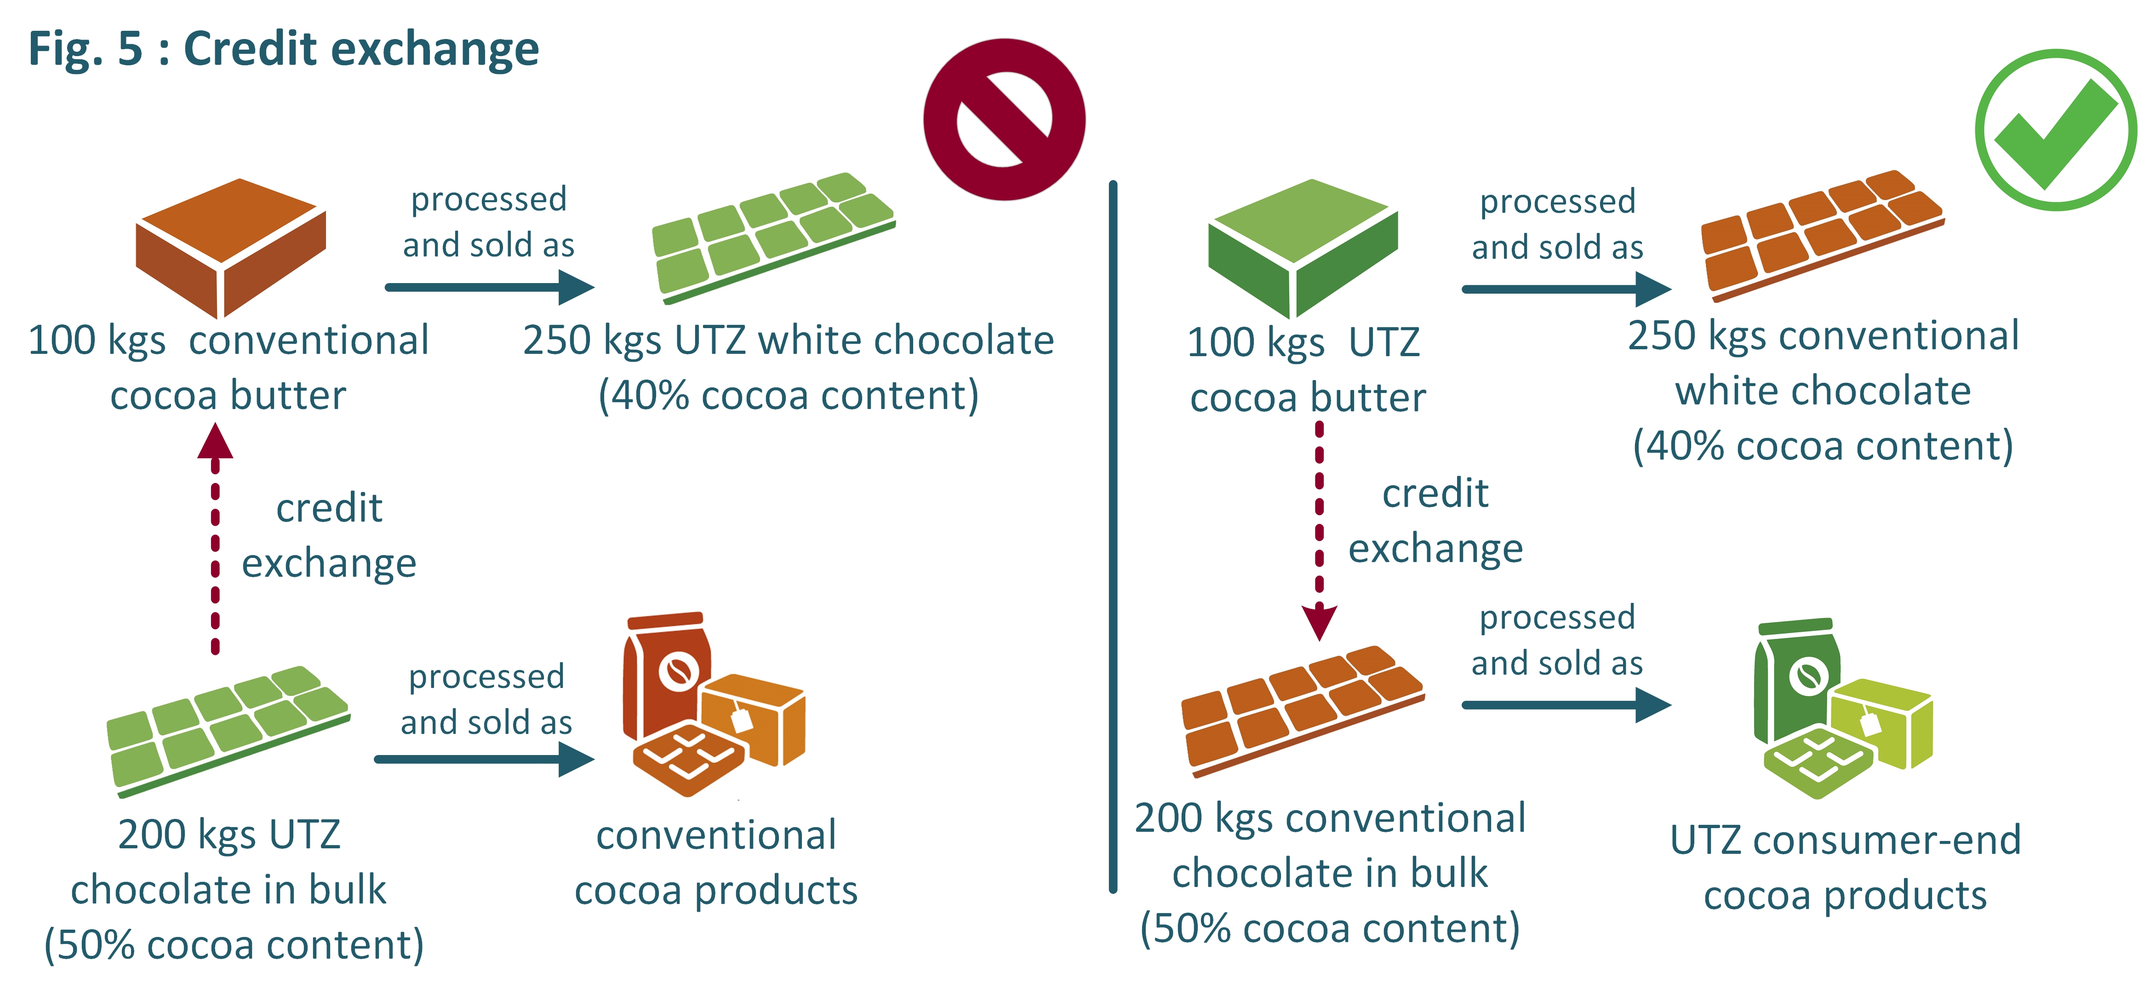
Credit exchange II
After July 1st
2016
Currently MB permits exchange of credits between or from:
UTZ non-pure cocoa products conventional non-pure cocoa products
UTZ pure cocoa products conventional non-pure cocoa products
Credit exchange is not allowed for:
UTZ non-pure cocoa products conventional pure cocoa products
Notes:
Currently, credits can also be exchanged between pure and non-pure cocoa products in any direction. Remember, pure cocoa products are cocoa beans, nibs, liquor, butter, and powder, and non-pure products are cocoa products which have been mixed with sugar, milk, etc. SCAs only have to calculate their total cocoa input and their total cocoa output, and ensure that the balance is positive. However, following July 2016, there will be some limitations to the direction in which credits can be exchanged. Credit exchange will only follow the direction of physical processing. Credits from UTZ pure products can be used for non-pure products, but credits from non-pure UTZ products will not be used to claim pure products.
Let’s illustrate with an example: looking first at the right side, credits from UTZ cocoa butter can be transfered to conventional chocolate in bulk, in order to sell products made from the chocolate in bulk as UTZ. This is allowed now, and also in the future.
However, after July 1st 2016, it will not be allowed to exchange credits from non-pure products to pure products as you see on the left side. For instance, using credits from UTZ chocolate in bulk is not possible to certify conventional cocoa butter used for UTZ white chocolate. Until July 1st 2016, this is still permitted.
This will have implications on how SCAs maintain a credit account. Credit accounts will have to show the balance of each cocoa liquor, butter, powder, and non-pure products.

Slide 52
Credit Accounts
Who needs to maintain a credit account?
Any SCA that buys and/or sells mass balance non-pure cocoa or hazelnut products, as these transactions are not registered in the traceability system.
Notes:
Any supply chain actor that buys and of sells mass balance non-pure products need to maintain a credit account because transactions of non-pure cocoa products are not registered in the GIP. Remember when we talk about non-pure products, we talk about cocoa products that have other ingredients in addition to the cocoa inside the product. These include chocolate in bulk or compound.

Slide 53







Why is a credit account so important?
Ensures traceability of UTZ volumes for members who do not trade exclusively in the UTZ traceability platform. Provides an overview of all purchases and sales of UTZ volumes, indicating the balance of UTZ volume purchased – UTZ volume sold.
credit account
credit account
Producer
Exporter
Grinder
Chocolate Manufacturer
Consumer-end Manufacturer
Retailer
GIP
GIP
GIP
GIP
GIP
100 kgs UTZ cocoa beans
100 kgs UTZ cocoa beans
82 kgs UTZ cocoa liquor
UTZ chocolate in bulk
UTZ consumer-end products
Notes:
The credit account is important because it ensures the traceability of UTZ cocoa volumes for members who do not trade exclusively in the GIP. The GIP is our main tool for ensuring traceabilty throughout the supply chainLet’s have a look at a typical cocoa supply chain, and how UTZ traceability is ensured. We start with the producer who sells cocoa beans probably to an exporter, who might sell cocoa beans to a grinder. The grinder might sell cocoa liquor to a chocolate manufacturer, who will then sell chocoate to a consumer-end manufacturer. This last actor sells UTZ consumer-end cocoa products to retailers. The first transaction from the Producer to the Exporter is registered in the GIP, as is the transaction between the exporter and the grinder. The grinder will also to another action in the GIP called “Convert” to convert the beans into liquor, and then sell cocoa liquor to a chocolate manufacturer through the GIP. Cocoa beans and cocoa liquor are pure cocoa products. Once the chocolate manufacturer mixes the cocoa liquor with non-cocoa ingredients such as sugar, the product will no longer be sold in the GIP. Consumer-end manufacturers do not either sell their products to retailers in the GIP. For these actors who do not sell products in the GIP, they keep records of their volumes purchased and sold in a credit account. Retailers do not maintain credit accounts as they are not certified members in the UTZ program.

Slide 54
Control Point 19 and 20
“The SCA makes an overview ofthe total annual volume purchased and sold of UTZ certified product. The overview includes: stock remaining from the previous year; inputs received; outputs sold.[…]”
“If volumes of UTZ product have been over claimed (i.e. the SCA has sold more UTZ product than they have purchased), there is proof (i.e. a purchase order) with an expected delivery within two months of UTZ certified product which fully compensates for the negative credit balance.”
Notes:
The Chain of Custody requires that SCAs make an overview of the total annual volume purchased and sold of UTZ Certified product. The aim of the overview is to show that the SCA has not sold more product as UTZ than what they have purchased.

Slide 55
Elements of a credit account
Only UTZ inputs and UTZ outputs need to be included in the credit account!
Must include:
balance remaining from the previous year;
volume of UTZ product purchased;
pure product content (% and/or kg or MT) in UTZ product purchased;
quantity of UTZ product sold;
pure product content in UTZ product sold (% and/or kg or MT);
« recipe » (volume of UTZ product used per unit of UTZ product sold).
Can also include:
purchase/delivery dates, sales dates;
shipment references (order number, invoice number, etc.);
GIP transaction IDs corresponding to each purchase of pure UTZ certified product;
GIP unique traceability number corresponding to product traced;
conversion rates.
Notes:
IN summary, here is a list of the elements which can be included in the credit account. This list also appears in CP…It is not mandatory to include all of them; what is important is that the credit account includes enough information to verify that all UTZ products purchased and sold have been included in the credit account, and that the balance has been correctly calculated.
Next, you will be completing an assignment where you yourself will input information into a credit account.

Slide 56
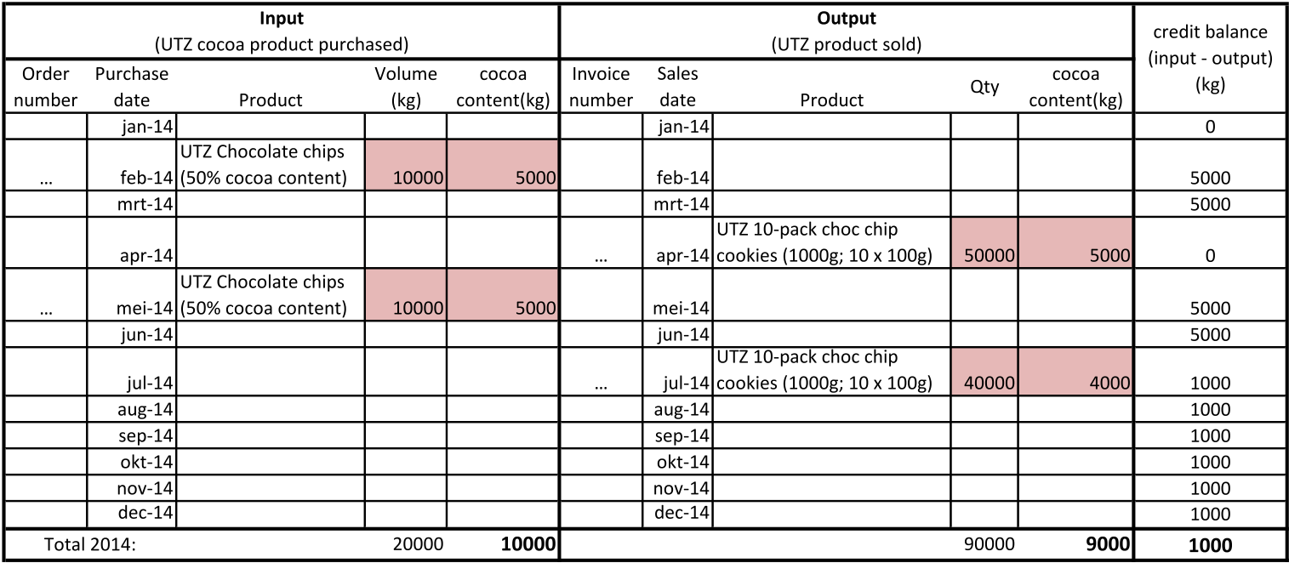
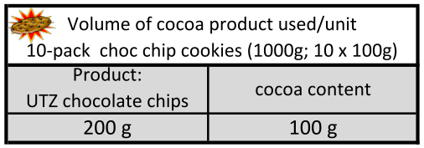
Example: Credit Account of a Consumer-end Manufacturer
Invoice number
Quantity of UTZ product sold
Total cocoa content in volume purchased
UTZ volume purchased
Total cocoa content in UTZ product sold
Credit balance
Order number
Purchase date
Recipe
Notes:
Here we will show you an example of what a credit account could look like, and what elements can be included. In this particular case, the credit account represents a consumer-end manufacturer who purchases UTZ chocolate chips and uses them for chocolate chip cookies sold as consumer-end products. On the input side, a SCA can indicate the order number and purchase date of the UTZ purchase. This enables you to relate sales documentation with what is entered in the credit account. The volume of product purchase, and very importantly the volume of pure cocoa in the product is important to indicate. On the output side, the SCA can indicate the invoice number and the sales date (again, so you can verify that all products included in sales documentation are included in the credit account. The SCA indicates the quantity or volume of product sold, the cocoa content in that amount of product sold, and of course a running balance of the inputs minus the outputs. It is also useful to have the recipes which indicate the cocoa product included in the products sold, in order to verify the calculations. In this example, the SCA has a positive credit balance, so they are compliant.

Slide 57
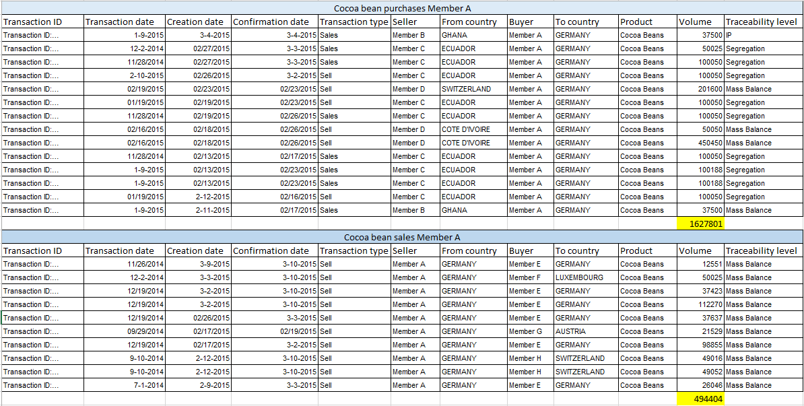
SCAs who trade only pure products
The annual overview can be extracted from the GIP (for cocoa members) or MultiTrace (for hazelnut members) and a credit account is hence not needed:
Notes:
SCAs who trade only pure products and register all transactions in the GIP can extract an overview of all transactions registered in the GIP, and use this as their overview of inputs purchased and outputs sold. If all purcahses of UTZ product are registered in the GIP, it is not possible to overclaim volumes as UTZ, as the GIP will not let you sell more than what you have in your GIP stock.

Slide 58
One exception to the rule
For supply chain actors whose input is 100% UTZ = no credit account needed

Slide 59
Use of the Traceability Platform for Tracing/Redeeming and Labelling Approval Requests

Slide 60
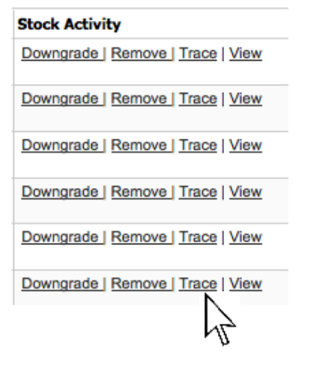
“Tracing” (tea in Good Inside Portal/ “Redeeming” (coffee in MultiTrace)
What is it?
The Trace function in the traceability system (GIP or MTT) is used by SCAs to book out from the online system the volume. purchased as UTZ certified once sold/processed onwards, which allows them to manage and keep their virtual stock up-to-date.
The trace function also:
marks the end of the online traceability
gives UTZ information of the volumes of UTZ product entering the market, and is important for preventing double-selling
In addition: in the coffee and tea programs, tracing automatically generates the invoice for the UTZ program fee.
Notes:
This action marks the end of the online traceability for the product or ingredient. It is what allows a member to prove that the coffee he/she is claiming as UTZ is linked to a certified supply chain.

Slide 61
When is a SCA required to “book out volumes”?
2 scenarios for tracing /redeeming coffee and tea:
1. When a supply chain actor packs coffee or tea into a consumer-end product
2. When a supply chain actor processes coffee or tea into solubles or any type of extract.
Soluble coffee and other extracts are not traded in the GIP/MTT! Actors who buy these products must keep documentary and physical traceability.

Slide 62

Important!
In the coffee and tea program, tracing/redeeming is required for all
manufacturers of consumer-end products who pack or make extracts, including volumes that are not sold as UTZ certified!
Notes:
It is important to remeber that Tracing is required for all manufacturers of consumer-end products who pack or make extracts, including volumes that are not sold as UTZ certified!

Slide 63
When is a SCA required to “book out volumes”?
3 scenarios for tracing cocoa:
When a pure cocoa product is mixed with non-cocoa ingredients and claimed as UTZ certified.
When credits from pure cocoa products are used to claim conventional non-pure cocoa products as UTZ certified.
When pure cocoa product is sold as a consumer-end product and claimed as UTZ certified.

Slide 64
How to check for tracing?
1. Ask member for a copy of their transaction report during or prior to the audit and cross check with documentation (e.g. invoices, delivery notes).
2. Randomly select from documentation (e.g. invoices, delivery notes) and ask the member to demonstrate that tracing has been performed.
3. Ask the member to enter the GIP/MTT during the physical audit demonstrate which activities have been performed.

Slide 65
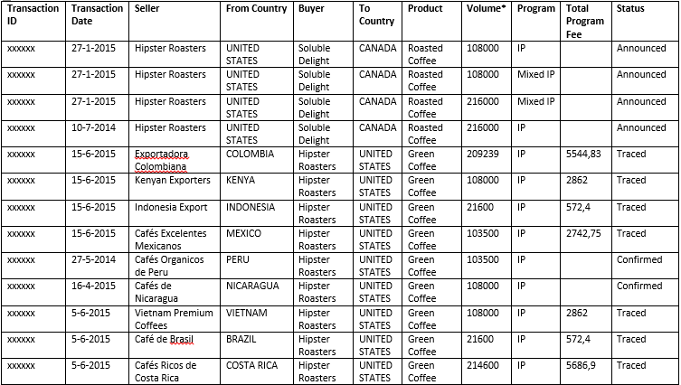
Example Transaction Report
Notes:
In this example, you are auditing Hipster Roasters. You are able to see that some volumes have been traced, but some transactions remain only confirmed. It would be important to verify why two transactions have only been confirmed, and not yet traced.

Slide 66
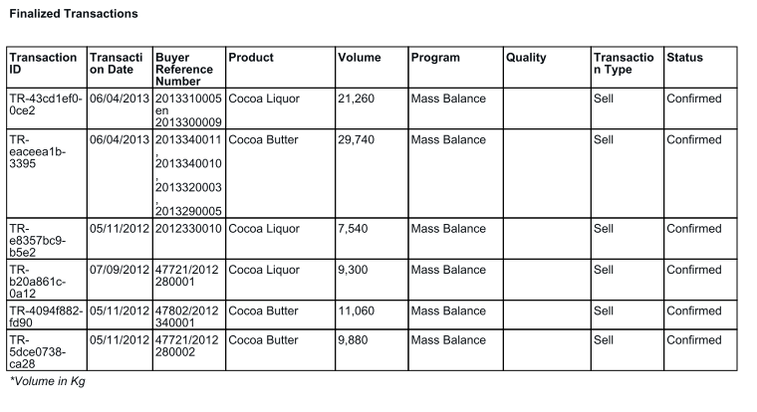
Poor use of GIP (chocolate manufacturer)
No tracing, although butter and liquor are used to manufacture chocolate!
Notes:
As an auditor, you should check if the member has traced volumes in these situations where they are required to trace. This can be checked by verifying the transaction report. This example shows a chocolate manufacturer who is buying liquor and butter, however no tracing transactions are registered. Considering they are a chocolate manufacturer, meaning they are mixing liquor and butter with sugar, milk, and other ingredients, they should be tracing. As the volumes are not sold onwards in the GIP, they need to be traced so that the member no longer has them in their stock.

Slide 67
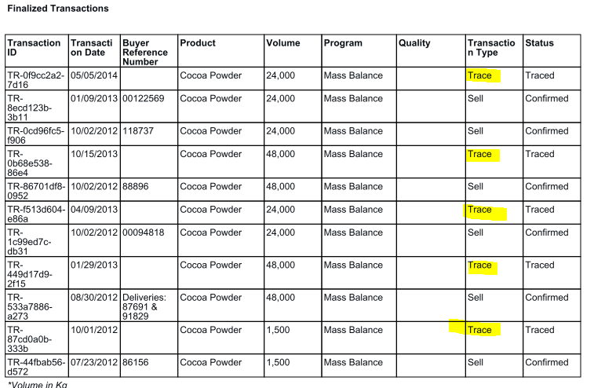
Good use of GIP
Cocoa powder is purchased and traced when processed with other non-pure cocoa ingredients.
Notes:
This example of a transaction report shows that tracing has been done. The manufacturer is purchasing cocoa powder, using it for the manufacturing of their products, and tracing the volumes as they should.

Slide 68
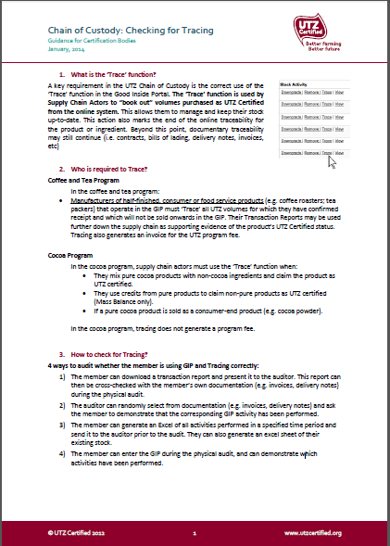
Need further guidance?
We have developed a guidance document for auditors on the topic of tracing. Please refer to it prior to your ChoC audit!
Notes:
Still have questions about tracing? We have developed a guidance document for auditors on the topic of tracing. Please refer to it prior to your ChoC audit!

Slide 69
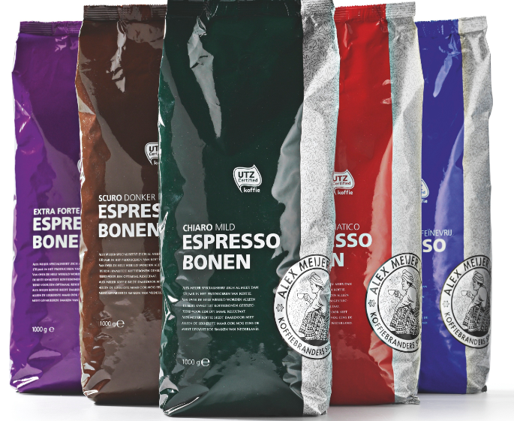
Product Claims and Labeling Approvals
The UTZ Chain of Custody requires that all consumer-packaging with an UTZ logo and/or claim is approved by the UTZ Certified offices prior to print.
Notes:
The UTZ Chain of Custody requires that all consumer-packaging with an UTZ logo and/or claim is approved by the UTZ Certified offices prior to print. UTZ Certified verifies that the package designs are compliant to the UTZ Labeling and Trademark policy.
In June 2014, UTZ Certified introduced a new section in the GIP that supports and facilitates an easier process for members to submit, manage and store their labeling. This is also where auditors can check whether the member’s packaging has been approved by UTZ Certified.

Slide 70
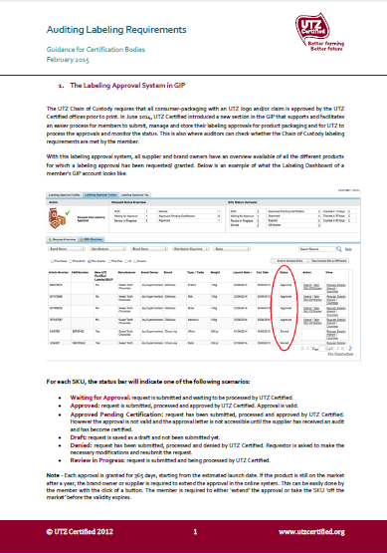
Need further guidance?
We have developed a guidance document for auditors on how to check for labeling approvals. Please refer to it prior to your ChoC audit!
Notes:
Need further guidance?
We have developed a guidance document for auditors on how to check for labeling approvals. Please refer to it prior to your ChoC audit!

